Slide 1
Garment Comparison Project
Women’s Pajamas
Zara Black

Slide 2
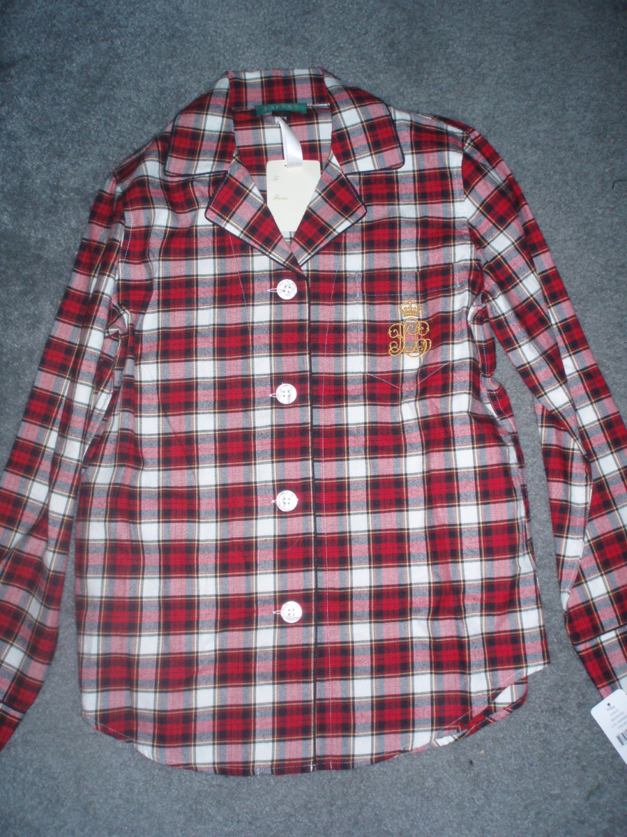
General Information
Lauren by Ralph Lauren
Dillard’s
$64
100% Cotton
Woven Flannel
Made in China

Slide 3
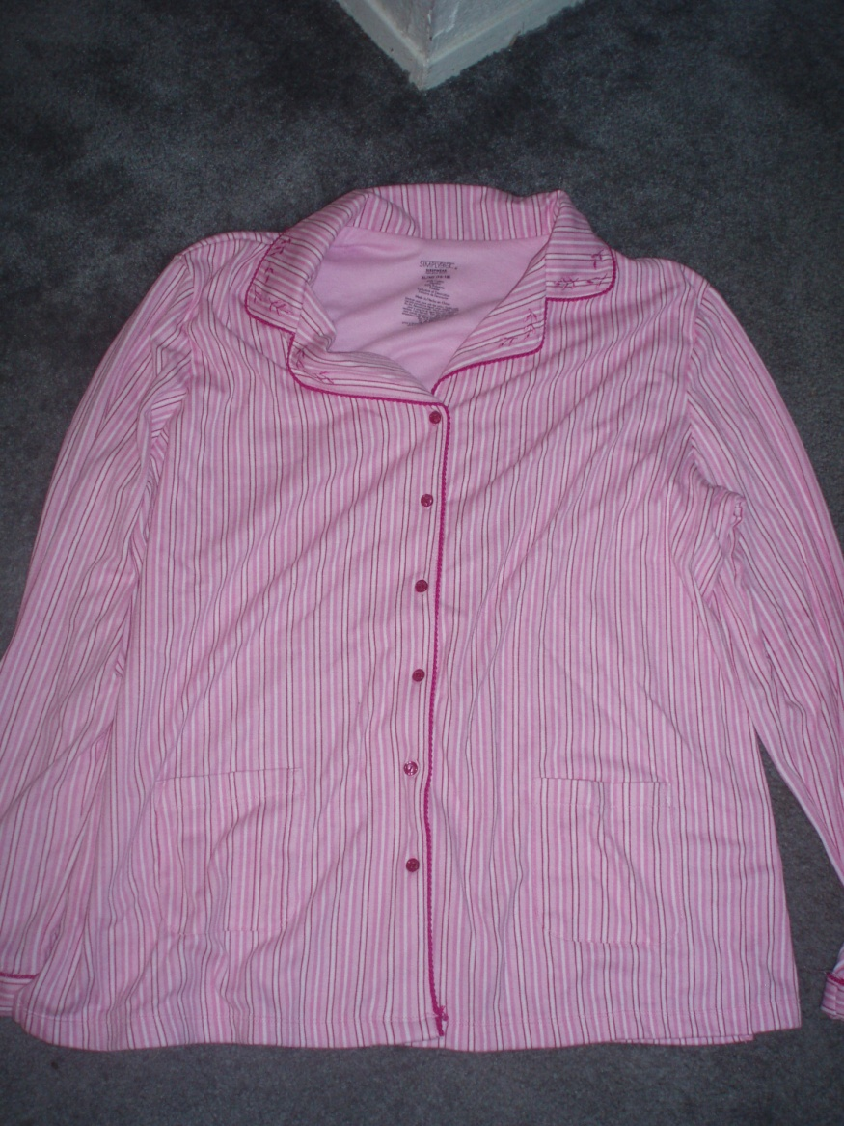
General Information
Simply Basic
Walmart
$13
60% Cotton, 40% Polyester
Jersey Knit
Made in China

Slide 4
Stitches and Seams
Ralph Lauren
11 SPI
301 safety stitch
Mock flat felled seam
Some bulky seams
Plaids do not match at sides
Simply Basic
11 SPI
Overedge stitch
Many loose threads
Raw edges
Missed stitches
Bulky seams

Slide 5
Collar
Ralph Lauren
Inside facing sewn down
Clipped, less bulky
Interfaced, symmetrical
Cheetah print under collar
Shows back seam
Simply Basic
Inside facing easily seen
Trim, interfacing not clipped
Loose threads
Interfaced, symmetrical
Does not show back seam

Slide 6
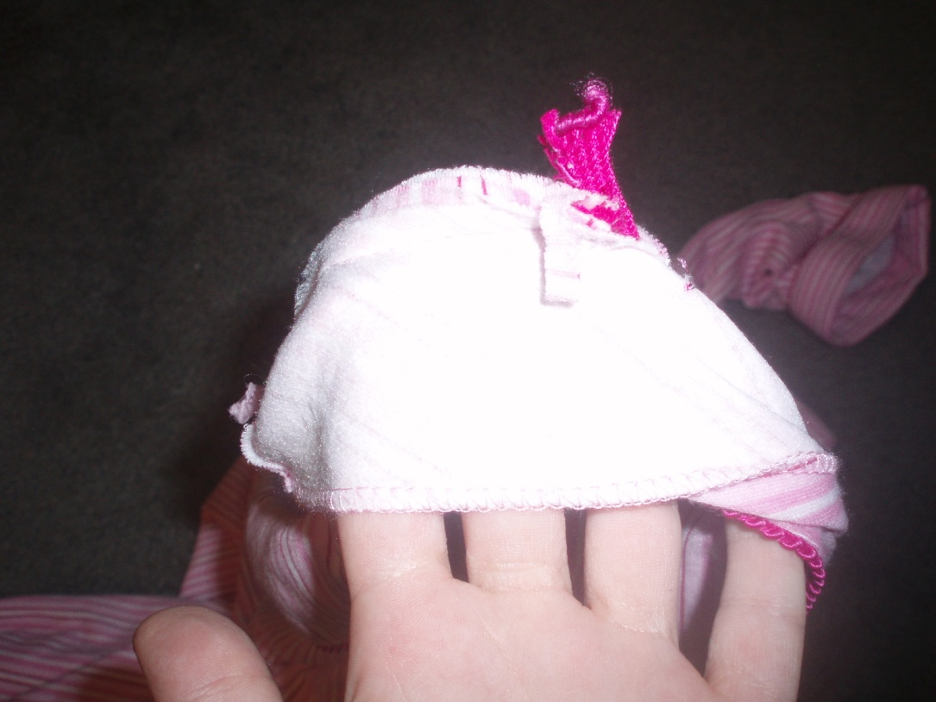
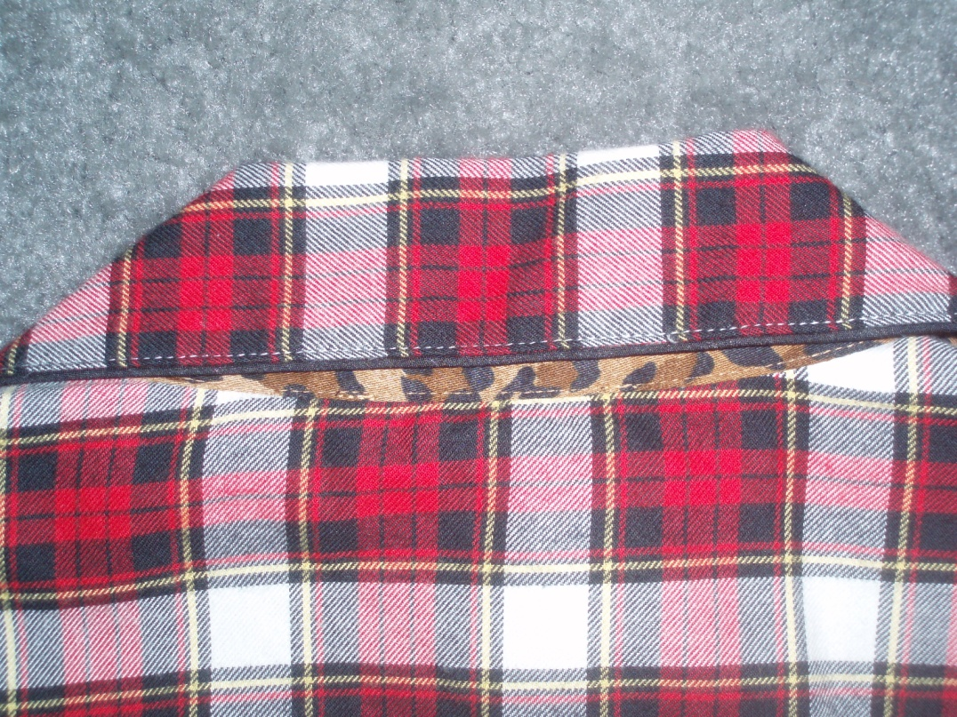

Slide 7
Waistline
Ralph Lauren
Elastic in casing
Drawstring casing
Simply Basic
Elastic sewn into casing seam
Skipped stitches

Slide 8
Aesthetic Details
Ralph Lauren
Embroidered insignia on pocket
Black piping
Simply Basic
Embroidery on collar
Pink cord trim

Slide 9
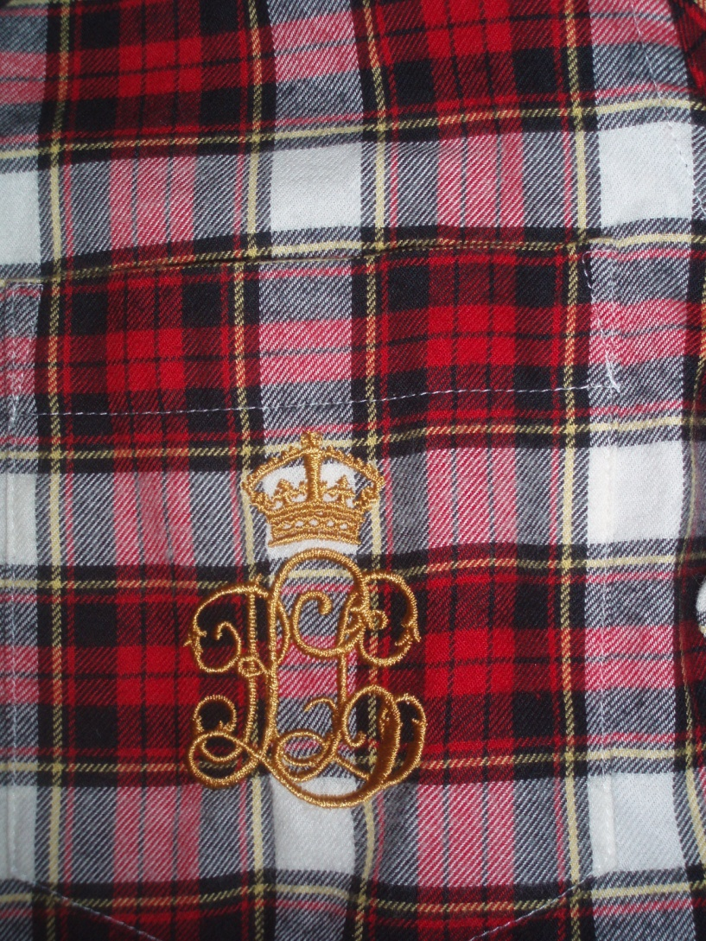
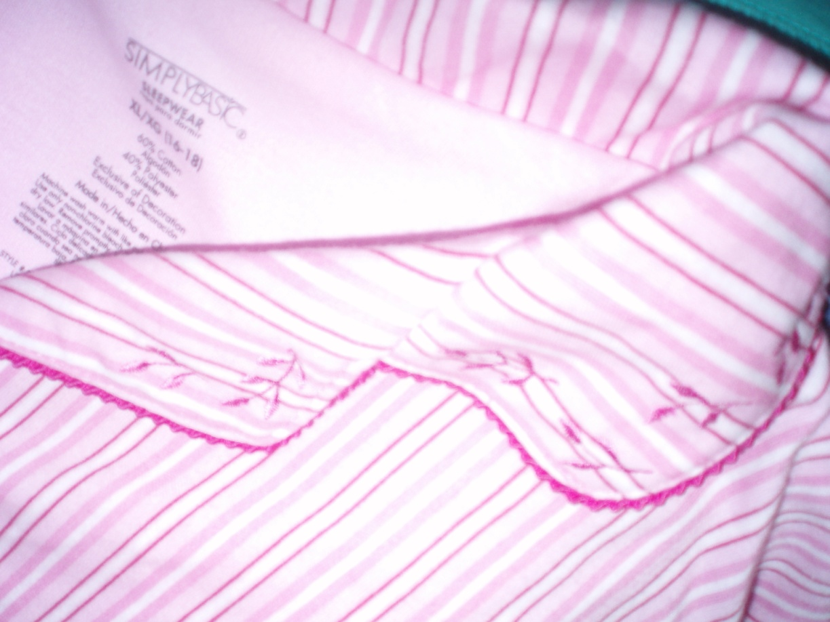

Slide 10
Closures
Ralph Lauren
4, 30 ligne buttons
Horizontal button holes
Ease of movement for older adults
Simply Basic
6, 18 ligne buttons
Vertical button holes
Lots of loose threads

Slide 11
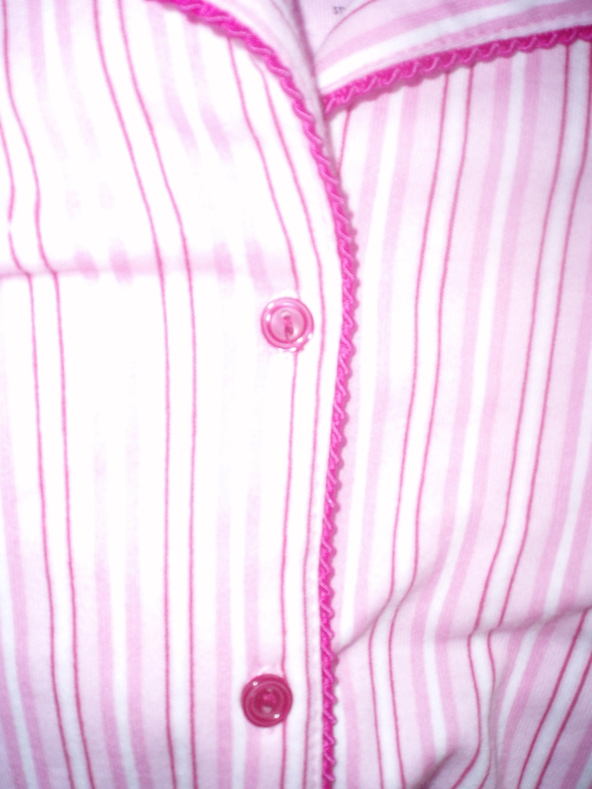
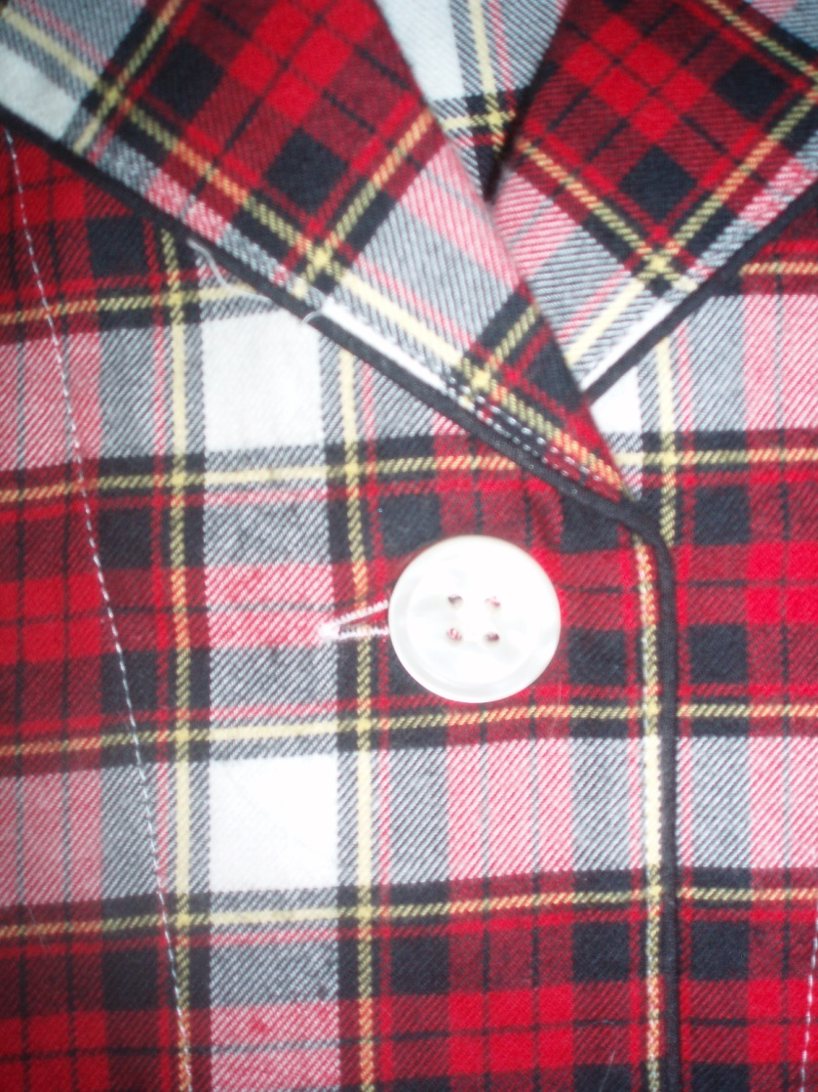

Slide 12
Conclusion
Ralph Lauren drawbacks
Collar seam shows
Plaids don’t match
Simply Basic drawbacks
Bulky seams
Unmanageable buttons
Loose threads
Poor stitches
Unfinished edges inside

Slide 13
Reference
Brown, P., & Rice, J. (2001). Ready-to-wear apparel analysis. New Jersey: Prentice Hall.

