Slide 1
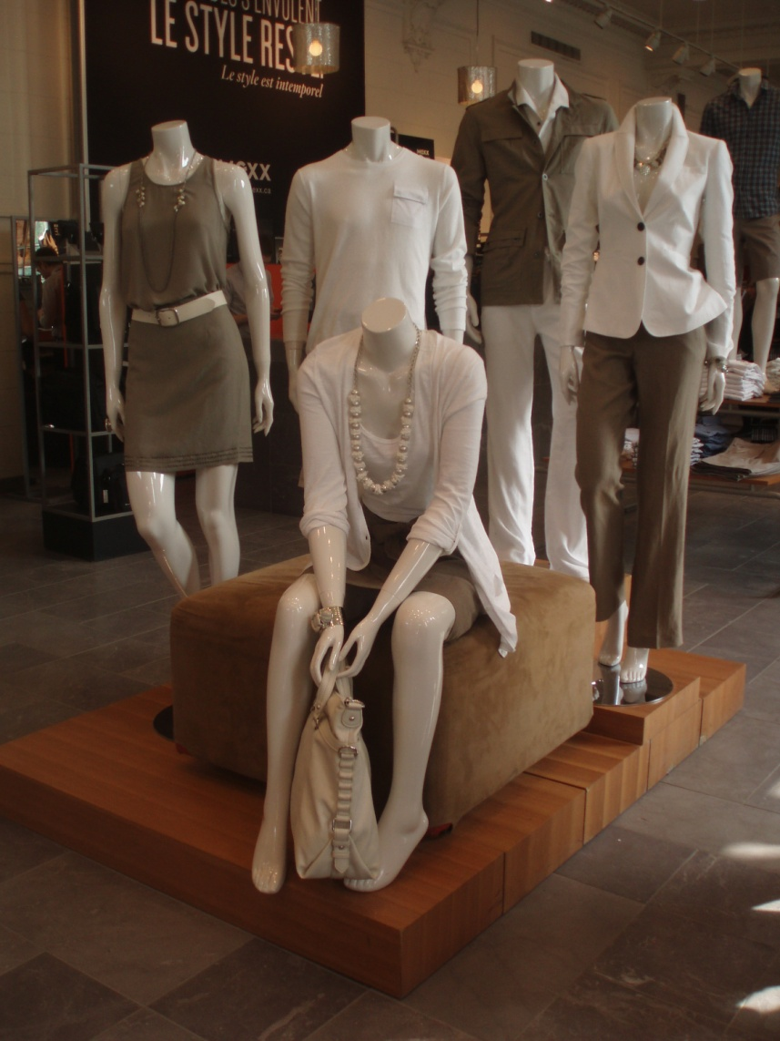
Merchandising
Zara Black

Slide 2
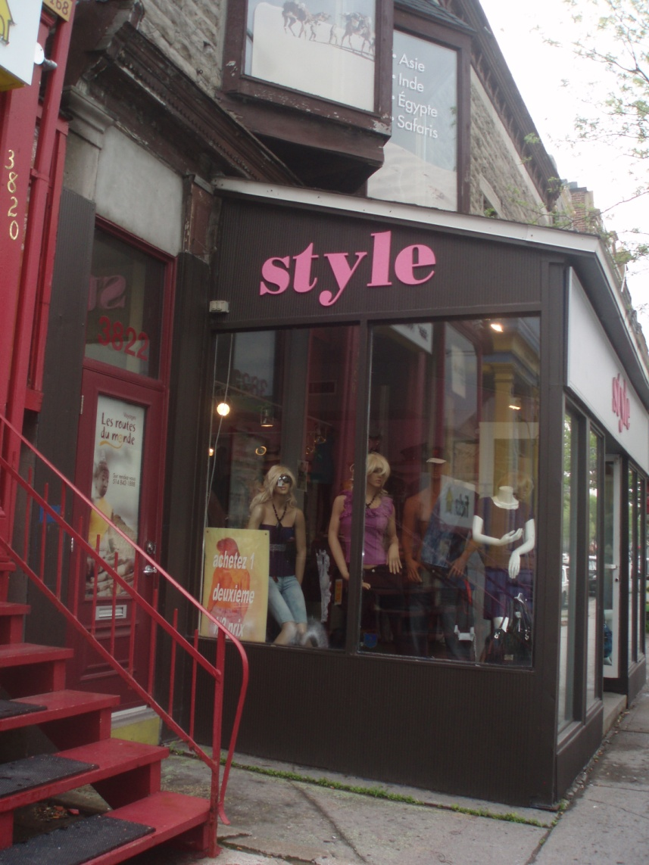
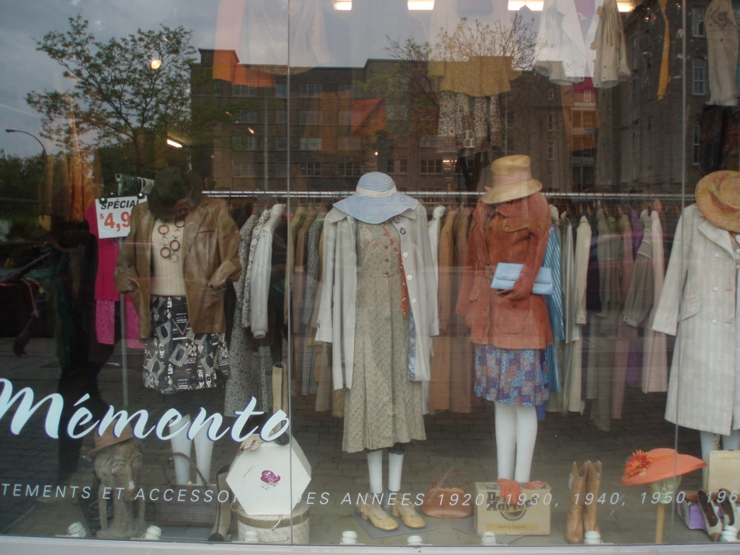
Window Displays
Montreal- simple mannequins
Notes:
First thing a customer notices. Range from extravagant to simple.

Slide 3
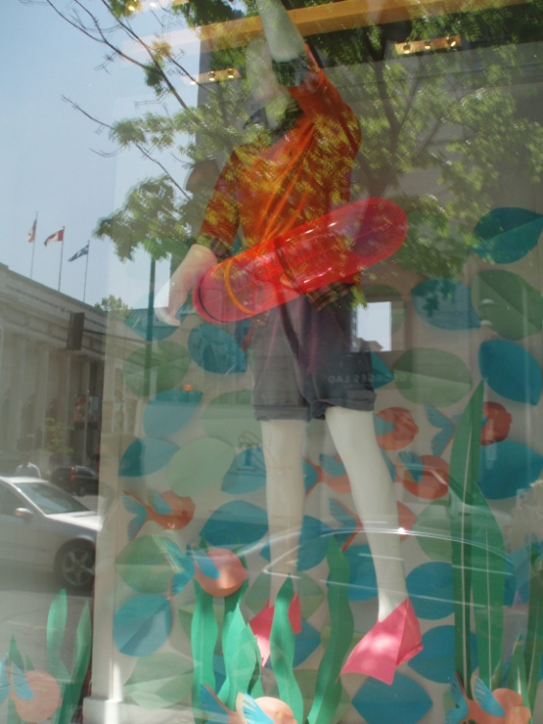
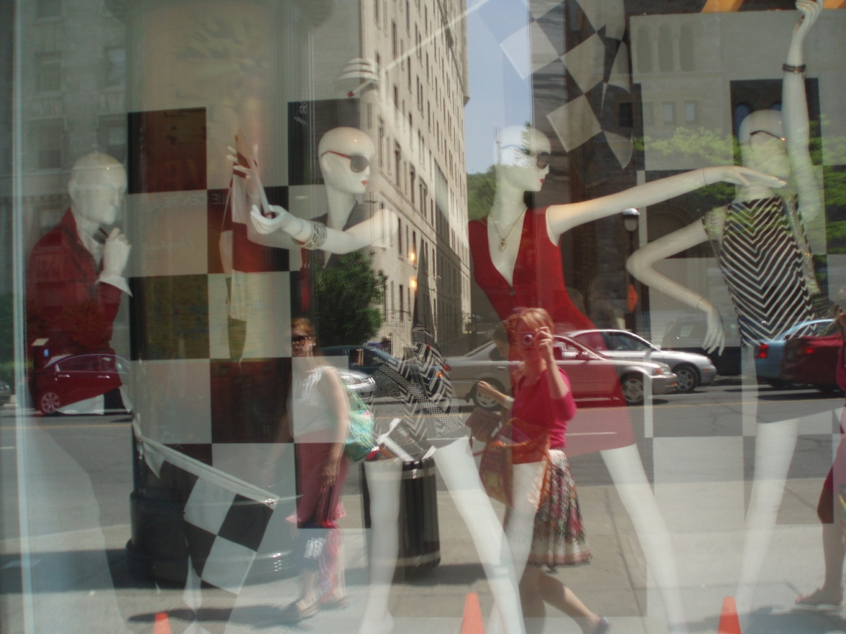
Holt Renfrew
More extravagant

Slide 4
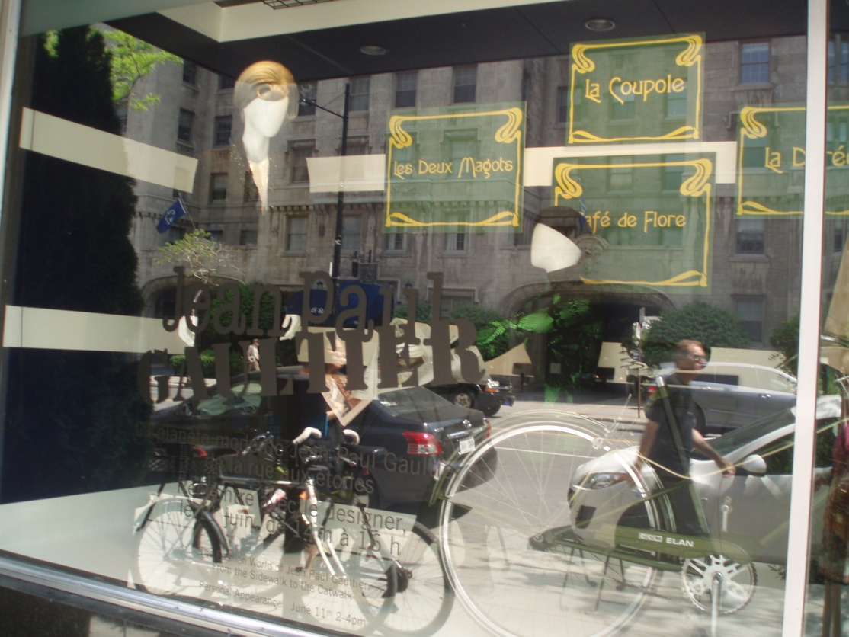
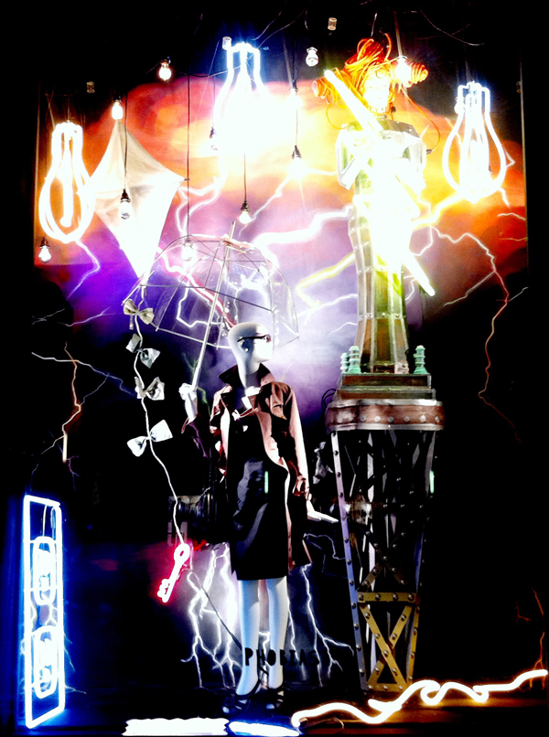
Bergdorf Goodman http://blog.bergdorfgoodman.com/windows/defenestraphobia

Slide 5
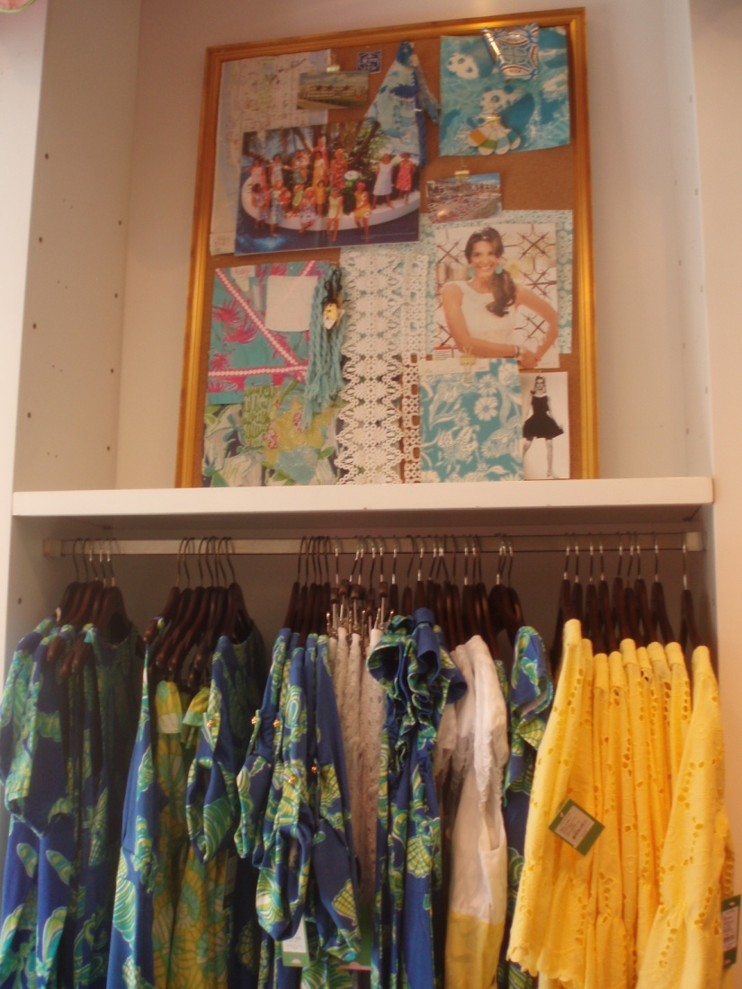
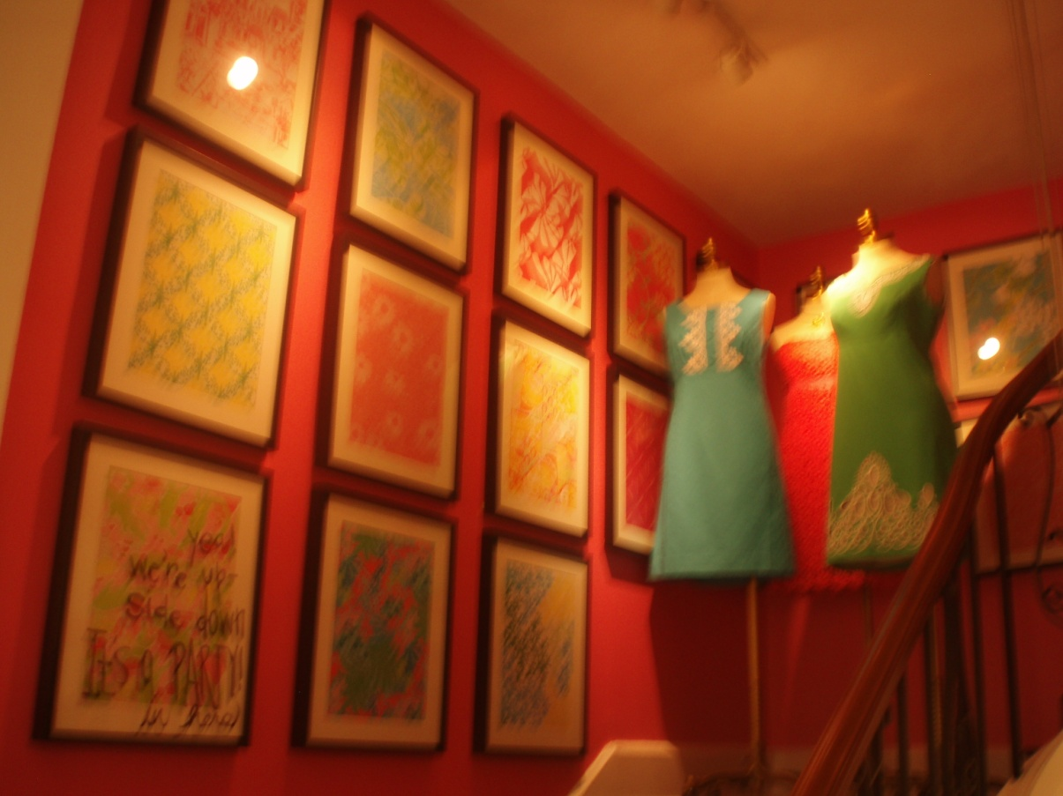
In Store Displays
Lilly Pulitzer

Slide 6
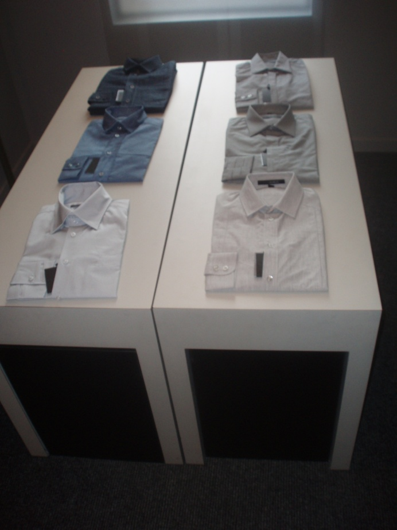
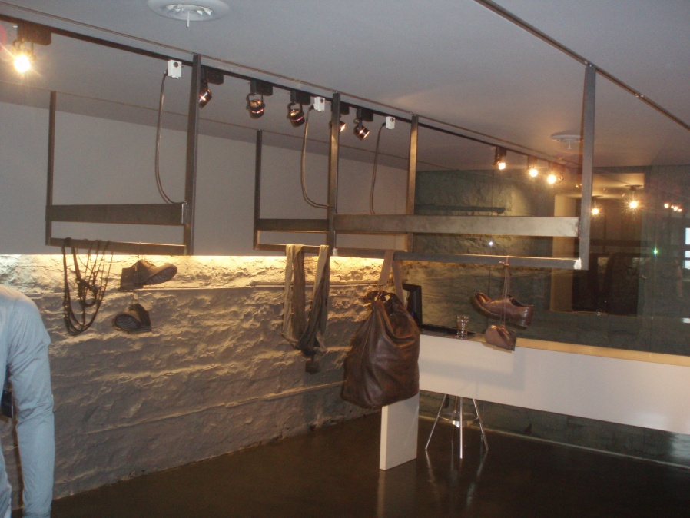
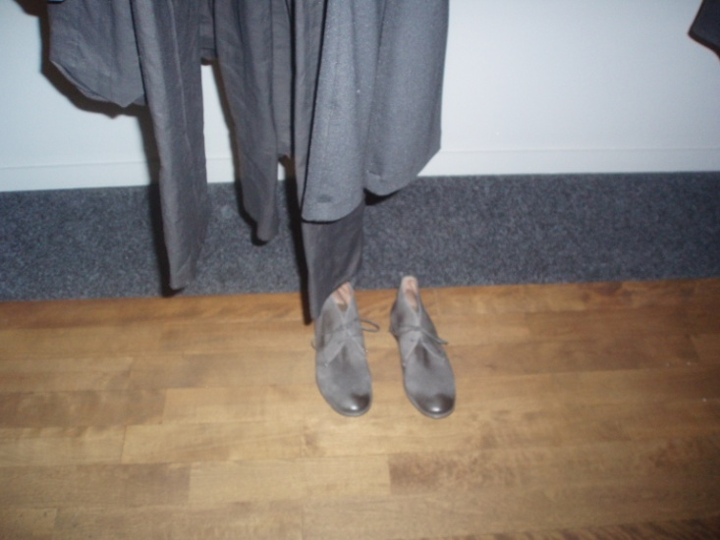
Phillipe Dubuc

Slide 7
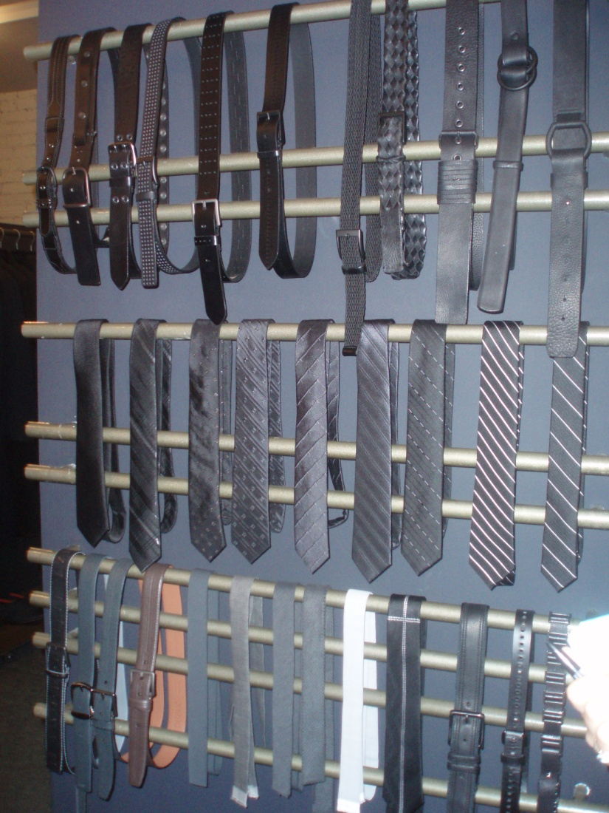
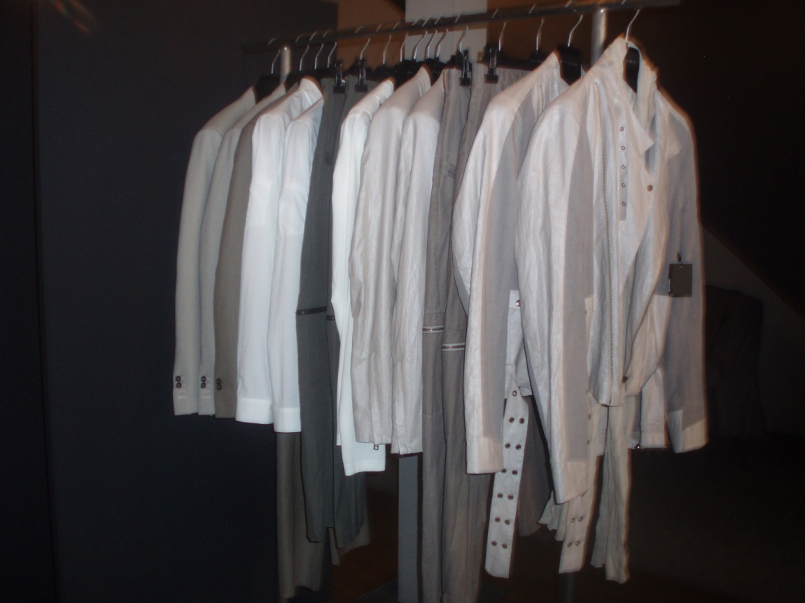

Slide 8
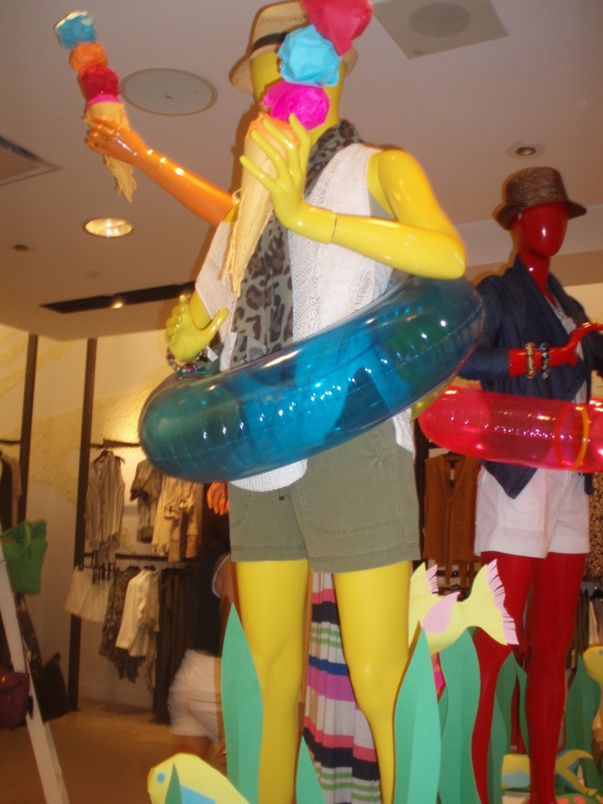
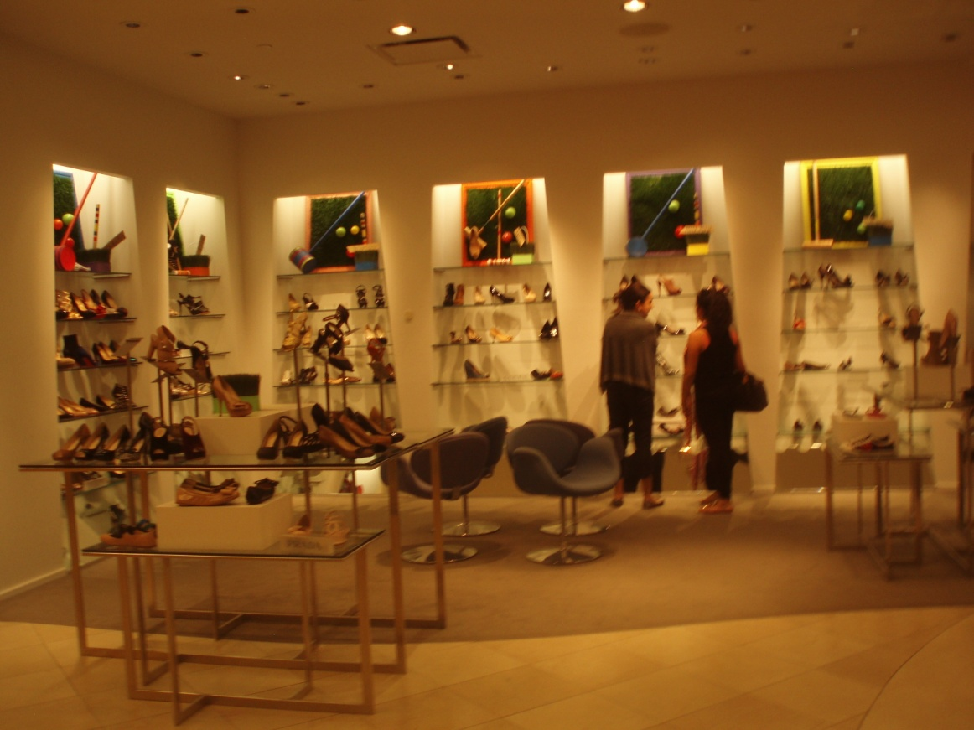
Holt Renfrew

Slide 9
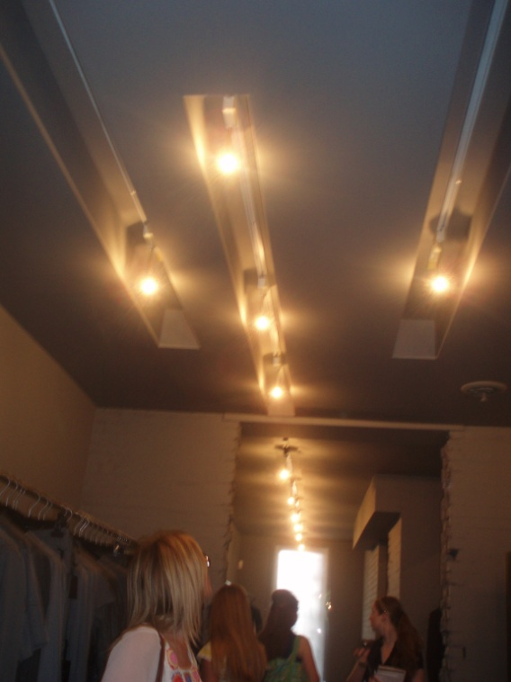
Layout
Macy’s cosmetics main floor-impulse sale
Designer floor-like boutiques
Junior floor- snacks, Jessica Simpson area
Dubuc track lighiting

Slide 10
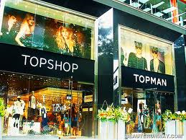
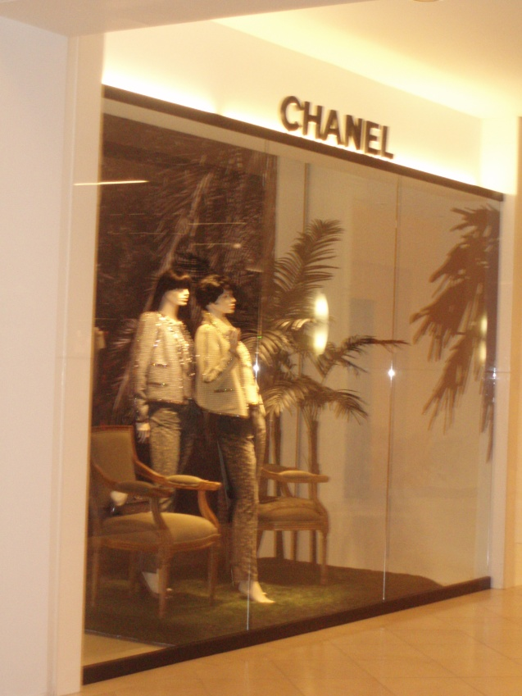
Topshop secret shop backseatstyler.com
Holt Renfrew
Shop in a shop
Designated Sales Associates

Slide 11
Pricing/ Merchandise Mix
Bod & Christensen- high price point, older customer. Vegan line less expensive.
Pink Tartan- know customer, merchandise mix smaller
Macy’s v. Holt Renfrew- atmosphere, target customer, some same designers
Uniqlo- low end mass, better allocation

Slide 12
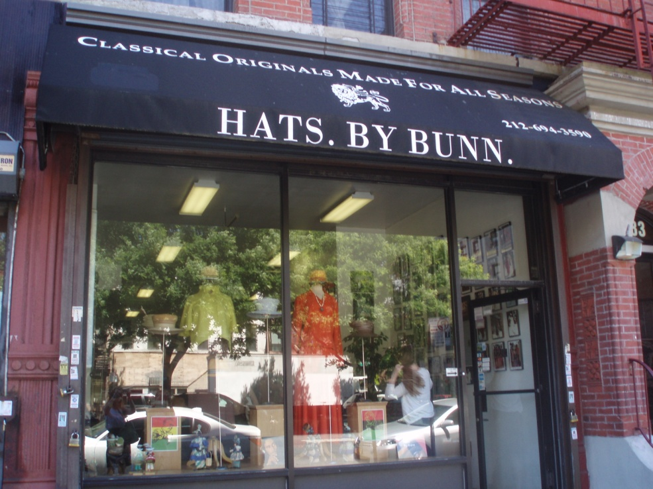
Retail Environment
Pink Tartan- lifestlye flagship
Hats by Bunn- relaxed, business outlook
Cokluch- shopfront/work space

Slide 13
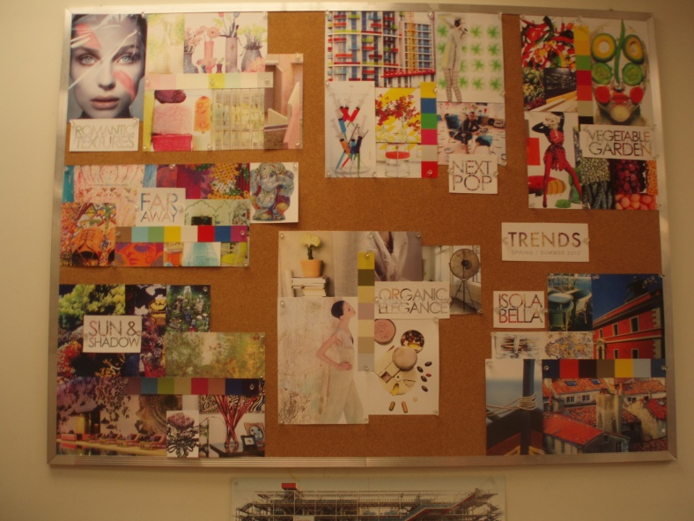
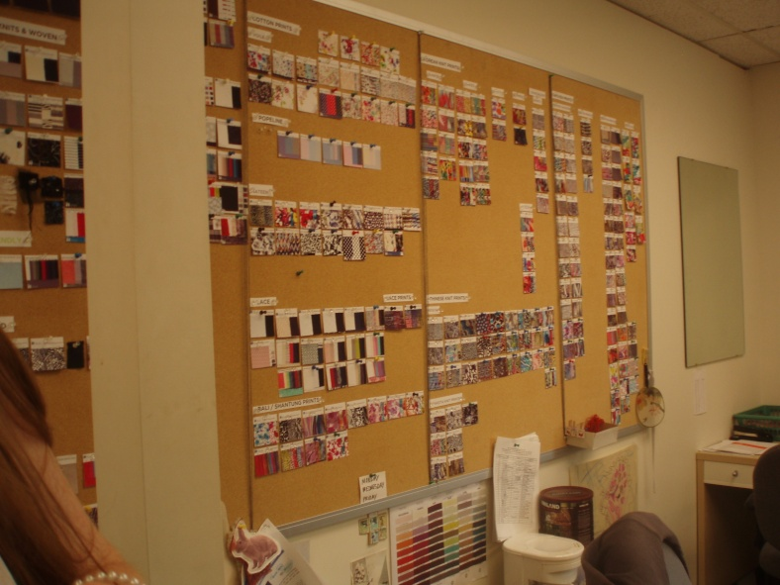
Allocation/ Trends
Tobe Report- companies use to predict merchandise trends
Telio fabrics- trend books, boards, right mix of fabrics for customers

Slide 14
Conclusion
Know target customer to get right mix
US over saturated, Canada room to grow

