Slide 1
Product Comparison Report
Women’s Pajama Pants
Zara Black

Slide 2
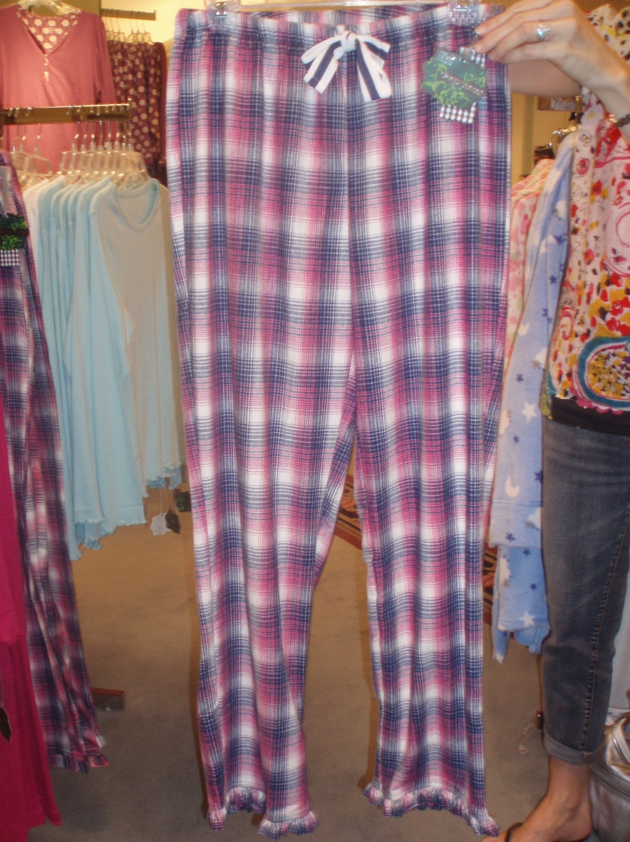
Dillard’s
Price: $28, or 2 for $44
Overall Style: Pink plaid pajama pants
Style Details: Ruffle at pants leg hem, drawstring casing, grosgrain ribbon
Fabric: Authentic Portuguese Flannel

Slide 3
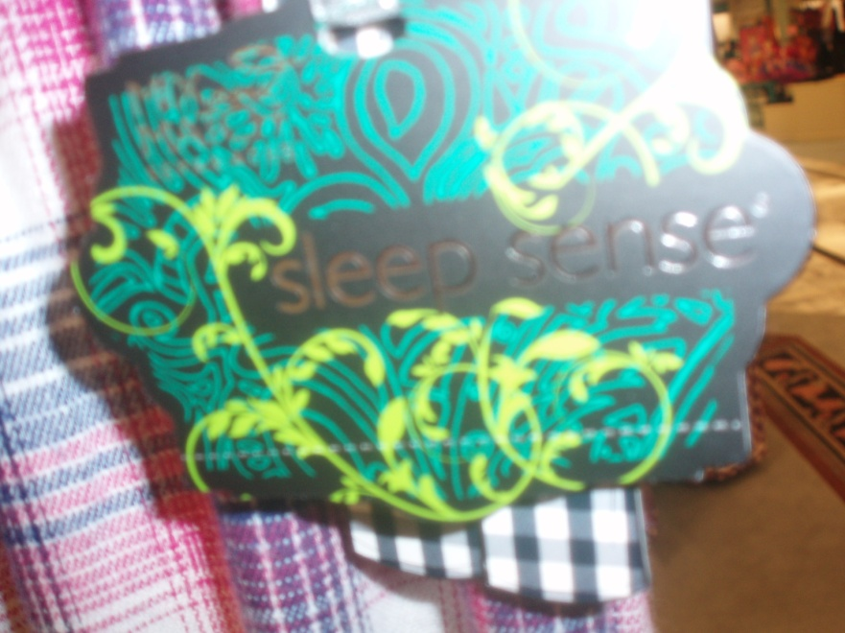
Fiber Content: 100% Cotton
Performance Claims/Cautions: Brushed on both sides for a softer longer lasting nap, highly durable but soft, resistant to pilling and thinning, shrink resistant, superior in colorfastness and vibrancy, won’t bleed or fade
Care Recommendation: Machine wash warm, non-chlorine bleach, tumble dry low, iron when needed

Slide 4
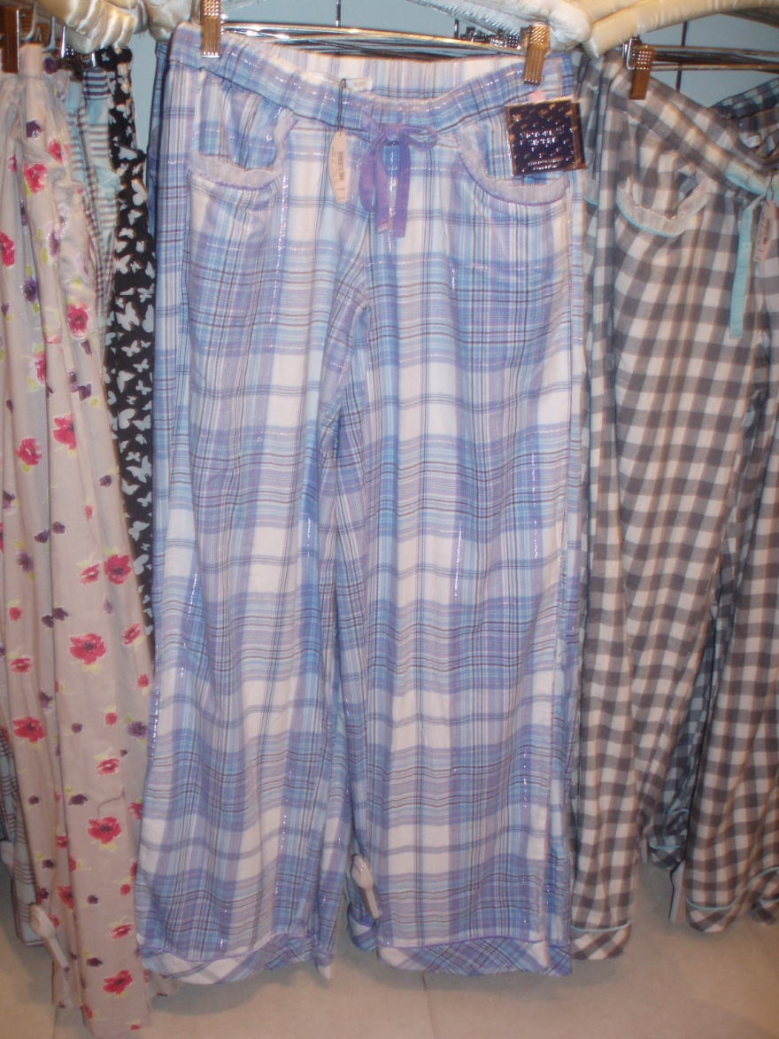
Victoria’s Secret
Price: $36.50
Overall Style: Blue plaid pajama pants
Style Details: Silver metallic thread in plaid, drawstring casing, two sided ribbon- grosgrain and velvet, ruffle on pocket with velvet piping, wide hem with velvet piping, brushed on outside
Fabric: Flannel

Slide 5
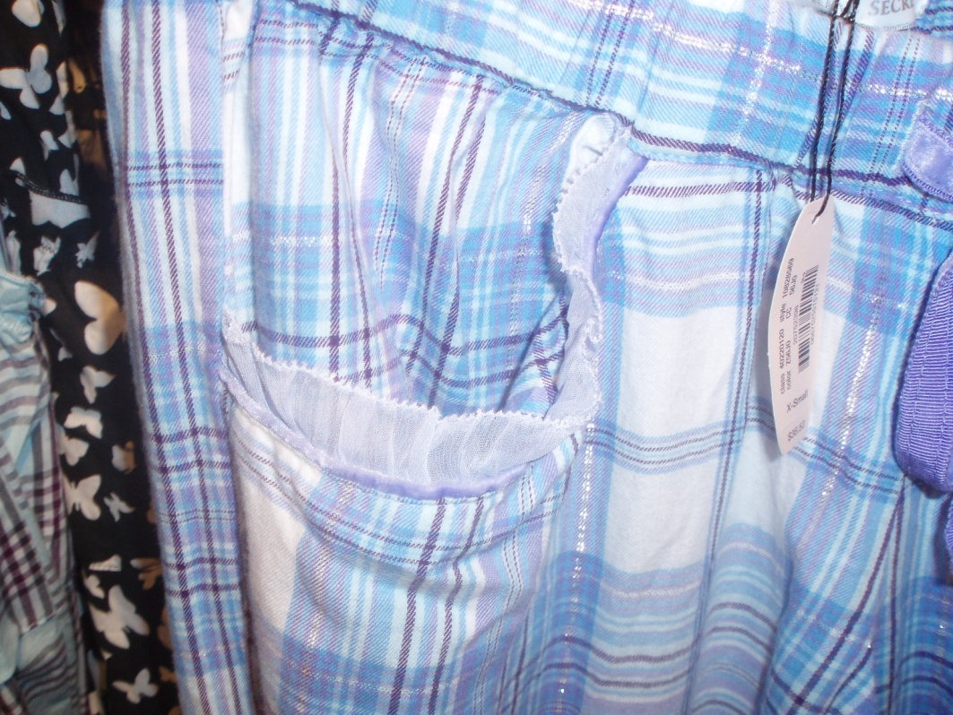
Fiber Content: 98% Cotton, 2% other fibers
Performance Claims/Cautions: None
Care Recommendation: Symbols, low heat iron, wash and dry low

Slide 6
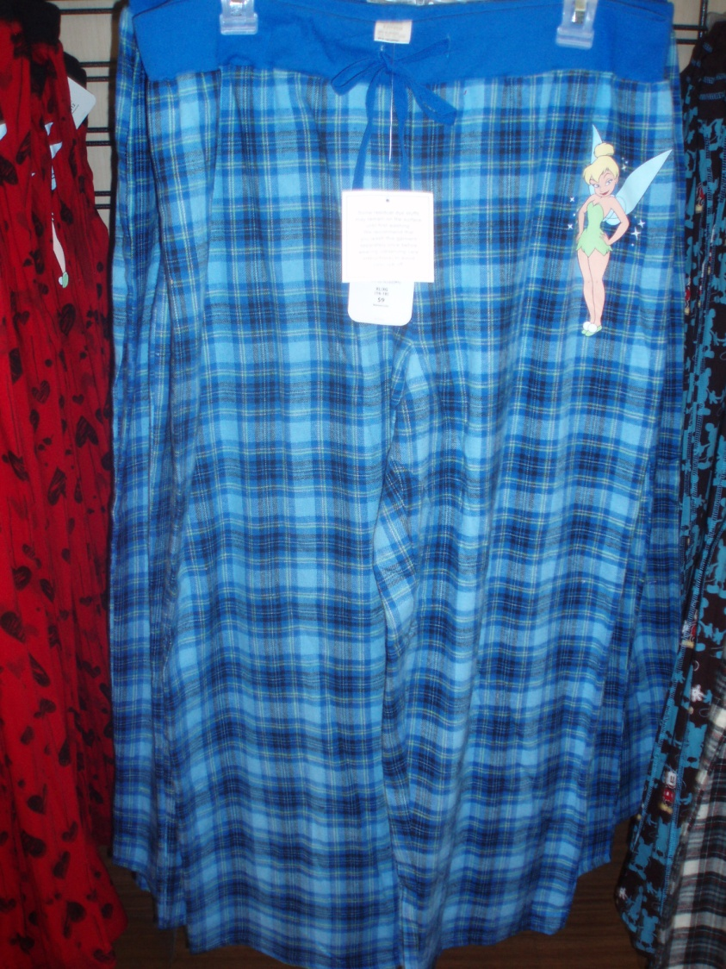
Walmart
Price: $9
Overall Style: Blue plaid pajama pants
Style Details: Tinkerbell picture printed on, brushed one side, drawstring casing, wide elastic band
Fabric: Flannel

Slide 7
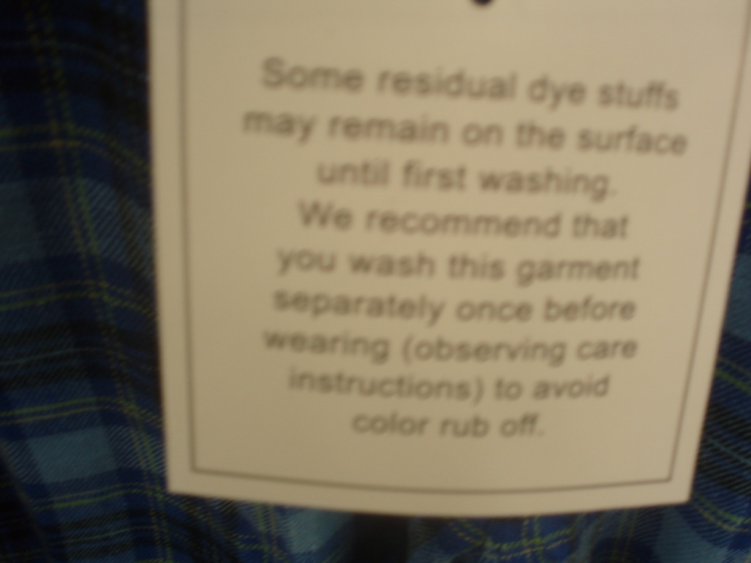
Fiber Content: 100% Cotton, made in China
Performance Claims/Cautions: Some residual dye stuffs may remain on the surface until first washing. We recommend that you wash this garment separately once before wearing (observing care instructions) to avoid color rub off.
Care Recommendation: Wash before wearing to remove excess dyes, turn inside out, machine wash cold with similar colors, delicate cycle, do not bleach, tumble dry low, use cool iron if needed on reverse side only

Slide 8
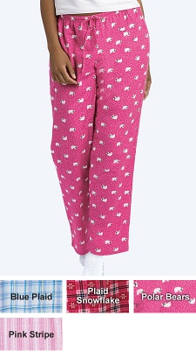
Hanes (online)
Price: $14.99 or two or more $12.99
Overall Style: Pink pajama pants
Style Details: Casing with twill drawstring, elastic waist, menswear inspired faux fly front, 31 inch inseam
Fabric: Flannel

Slide 9
Fiber Content: Washed brushed cotton, Imported
Performance Claims/Cautions: Pure cotton flannel pants deliver the ultimate in cozy and timeless comfort, colorful flannel pants also make a terrific gift, perfect for lounging or sleeping
Care Recommendation: None
http://www.onehanesplace.com/cgi-bin/ncommerce/ProductDisplay?prnbr=21740&cgnbr=7031000000

Slide 10
Similarities/ Differences
Ruffles
Colors
Fabric/Fiber
Care
Thickness of fabric
Price points
Claims

Slide 11
Target Market/ Approach
Dillard’s: Slightly older woman, had a lot of claims about quality
Victoria’s Secret: Younger woman, fashion savvy (style details)
Walmart: Lower income = lower quality, low price point
Hanes: similar to Dillard’s, woman looking for convenience

Slide 12
Analysis
Everything was what I expected to find. Price matched quality and reputation of retail establishment. The specialty store, Victoria’s Secret, had the most expensive product but also the one with the most details. The discount store, Walmart, had the cheapest product but also the worst quality.

